Slide 1


CS-429 Introduction to Data Science
Fall 2024

Slide 2
Lecture outline
Euclidean Distance
Manhattan Distance
Similarity Matrix (Cosine-Similarity)
Jaccard Distance
Hamming Distance
Mahala Nobis Distance

Slide 3
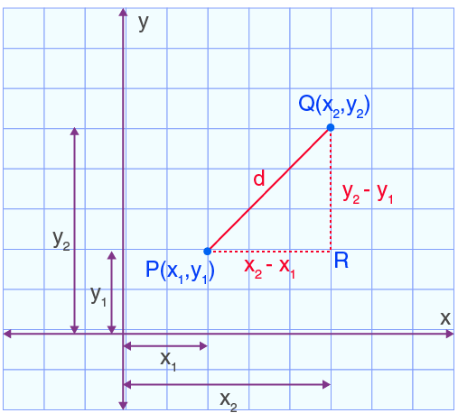
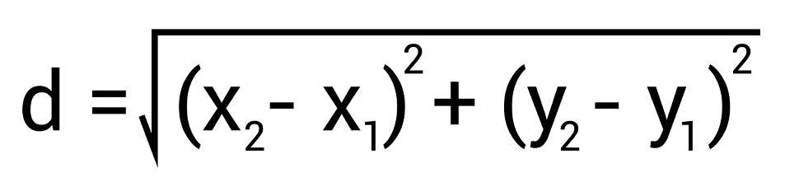
Euclidean Distance
It is one of the most commonly used measures to calculate the straight-line distance between two points
Formula
P(2, 3) :
x1=2, y1=3
Q(6, 8):
x2=6, y2=8
d = 6.4031242374

Slide 4
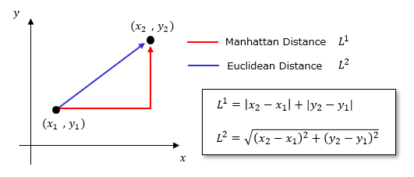
Manhattan Distance
It is also known as L1 norm or taxicab distance. It represents the path you would take if you could only move horizontally or vertically.
Formula

Slide 5
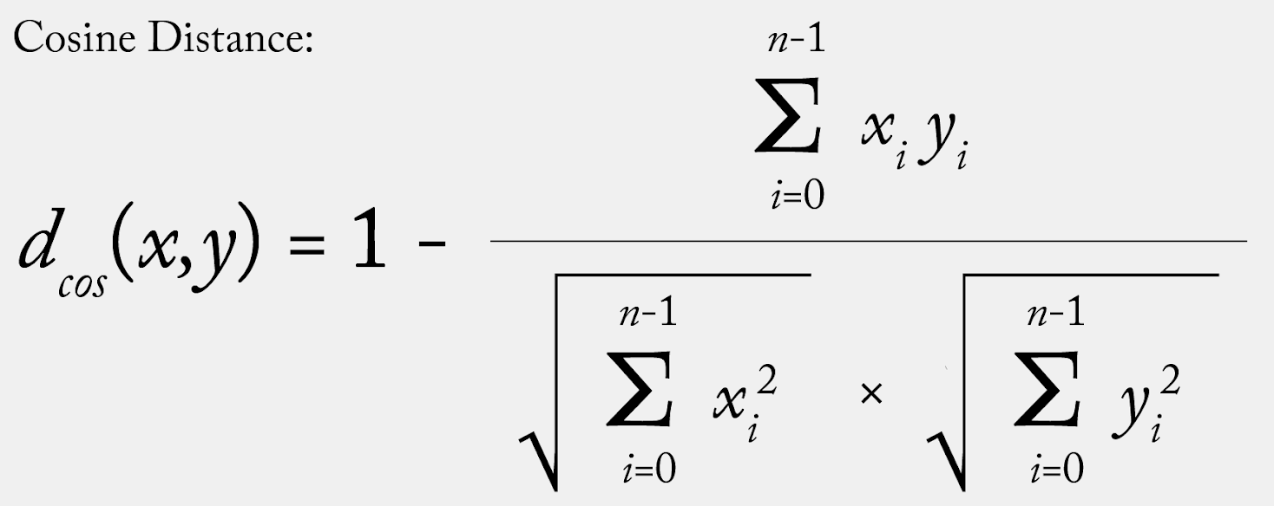
Cosine Similarity
Cosine Similarity is a measure that calculates the cosine of the angle between two vectors in a multi-dimensional space. It is often used in text analysis, information retrieval, and machine learning to determine how similar two objects (e.g., documents, data points) are, irrespective of their magnitude.
Formula

Slide 6
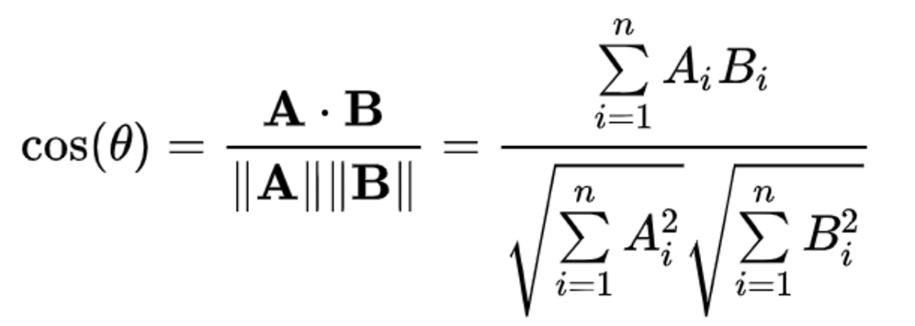

Cosine Similarity
Cosine Similarity measures the cosine of the angle between two none-zero vectors in a multi-dimensional space.
It ranges from -1 (opposite) to 1 (identical), with 0 meaning orthogonal (no similarity).
It is often used in text analysis, information retrieval, and machine learning to determine how similar two objects (e.g., documents, data points) are, irrespective of their magnitude.
is the dot product of vectors A and B.
are the magnitudes (lengths) of vectors A and B.

Slide 7
Example Cosine Similarity
Step 1: Define the text documents
Doc 1: “I love machine learning and artificial intelligence.”
Doc 2: “Machine learning is amazing and I love it.”
Step 2: Preprocess the documents (Tokenize the words):
Doc 1: [‘I’,‘love’,‘machine’,‘learning’,‘and’, ‘artificial’, ‘intelligence’]
Doc 2: [‘Machine’,‘learning’,‘is’,’amazing’,‘and’,‘I’,‘love’,‘it’]
Step 3: Create a term frequency (TF) vector
Combine unique words: [‘I’, ‘love’, ‘machine’, ‘learning’, ‘and’, ‘artificial’, ‘intelligence’, ‘is’, ‘amazing’, ‘it’].

Slide 8
Example Cosine Similarity
Doc 1: [‘I’,‘love’,‘machine’,‘learning’,‘and’, ‘artificial’, ‘intelligence’]
Doc 2: [‘Machine’,‘learning’,‘is’,’amazing’,‘and’,‘I’,‘love’,‘it’]
Step 3: Create a term frequency (TF) vector
Combine unique words: [‘I’, ‘love’, ‘machine’, ‘learning’, ‘and’, ‘artificial’, ‘intelligence’, ‘is’, ‘amazing’, ‘it’].
Create frequency vectors:
Doc 1: [1, 1, 1, 1, 1, 1, 1, 0, 0, 0]
Doc 2: [1, 1, 1, 1, 1, 0, 0, 1, 1, 1]
Step 4: Compute the dot product 𝐴⋅𝐵
𝐴⋅𝐵=(1×1)+(1×1)+(1×1)+(1×1)+(1×1)+(1×0)+(1×0)+(0×1)+(0×1)+(0×1)
𝐴⋅𝐵= (1) + (1) + (1) + (1) + (1) + (0) + (0) + (0) + (0) + (0) = 5

Slide 9
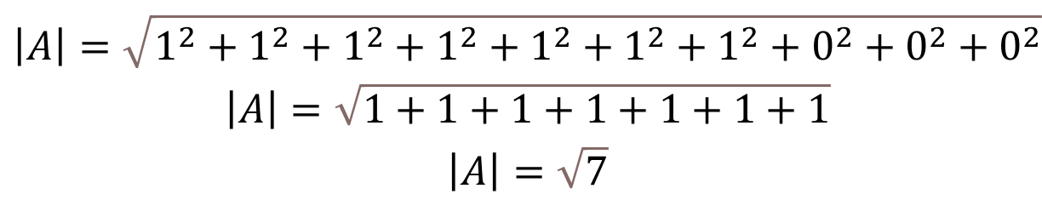
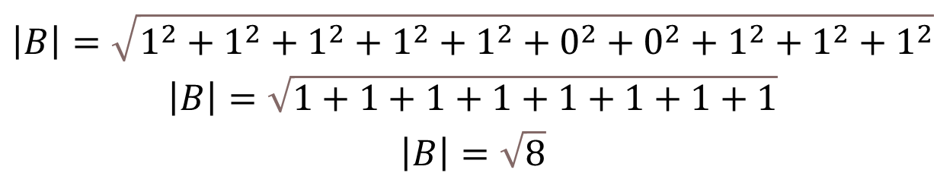
Example Cosine Similarity
Frequency vectors:
Doc 1: [1, 1, 1, 1, 1, 1, 1, 0, 0, 0]
Doc 2: [1, 1, 1, 1, 1, 0, 0, 1, 1, 1]
Step 5: Compute the magnitudes |A| and |B|
$$\begin{matrix}\left|A\right|=\sqrt{1^{2}+1^{2}+1^{2}+1^{2}+1^{2}+1^{2}+1^{2}+0^{2}+0^{2}+0^{2}} \\ \left|A\right|=\sqrt{1+1+1+1+1+1+1} \\ \left|A\right|=\sqrt{7}\end{matrix}$$
$$\begin{matrix}\left|B\right|=\sqrt{1^{2}+1^{2}+1^{2}+1^{2}+1^{2}+0^{2}+0^{2}+1^{2}+1^{2}+1^{2}} \\ \left|B\right|=\sqrt{1+1+1+1+1+1+1+1} \\ \left|B\right|=\sqrt{8}\end{matrix}$$

Slide 10

Example Cosine Similarity
Frequency vectors:
Doc 1: [1, 1, 1, 1, 1, 1, 1, 0, 0, 0]
Doc 2: [1, 1, 1, 1, 1, 0, 0, 1, 1, 1]
$$\begin{matrix}A.B=5 \\ \left|A\right|=\sqrt{7} \\ \left|B\right|=\sqrt{8}\end{matrix}$$
Step 6: Compute the cosine similarity

Slide 11
Ranking Documents Cosine Similarity
Step 1: Define the text documents

Slide 12
General Terms
Term Frequency (tf)
No of times a term occurred in a document
Document Frequency (df)
No of documents in which a term occurred.
Inverse Document Frequency
IDF = log(D/df)
where
D = total number of documents

Slide 13
Example 2 Cosine Similarity
Step 1: Define the text documents
Doc 1: “Shipment of gold damaged in a fire.”
Doc 2: “Delivery of silver arrived in a silver truck.”
Doc 3: “Shipment of gold arrived in a truck.”
Query : “gold silver truck”
Step 2: Preprocess the documents (Tokenize the words):
Doc 1: [‘Shipment’,‘of’,‘gold’,‘damaged’,‘in’, ‘a’, ‘fire’]
Doc 2: [‘Delivery’,‘of’,‘silver’, ‘arrived’,‘in’,‘a’,‘silver’,‘truck’]
Doc 3: [‘Shipment’,‘of’,‘gold’, ‘arrived’,‘in’,‘a’,‘truck’]
Query : [‘gold’,‘silver’,‘truck’]

Slide 14
Example 2 Cosine Similarity
Step 2: Preprocess the documents (Tokenize the words):
Doc 1: [‘Shipment’,‘of’,‘gold’,‘damaged’,‘in’, ‘a’, ‘fire’]
Doc 2: [‘Delivery’,‘of’,‘silver’, ‘arrived’,‘in’,‘a’,‘silver’,‘truck’]
Doc 3: [‘Shipment’,‘of’,‘gold’, ‘arrived’,‘in’,‘a’,‘truck’]
Query: [‘gold’,‘silver’,‘truck’]
Step 3: Create a term frequency (TF) vector
Combine unique words: [‘a’, ‘arrived’, ‘damaged’, ‘delivery’, ‘fire’, ‘gold’, ‘in’, ‘of’, ‘silver’, ‘shipment’, ‘truck’].

Slide 15
Example 2 Cosine Similarity
Step 2: Preprocess the documents (Tokenize the words):
Doc 1: [‘Shipment’,‘of’,‘gold’,‘damaged’,‘in’, ‘a’, ‘fire’]
Doc 2: [‘Delivery’,‘of’,‘silver’, ‘arrived’,‘in’,‘a’,‘silver’,‘truck’]
Doc 3: [‘Shipment’,‘of’,‘gold’, ‘arrived’,‘in’,‘a’,‘truck’]
Query: [‘gold’,‘silver’,‘truck’]
Step 3: Create a term frequency (TF) vector
Combine unique words: [‘a’, ‘arrived’, ‘damaged’, ‘delivery’, ‘fire’, ‘gold’, ‘in’, ‘of’, ‘silver’, ‘shipment’, ‘truck’].
Doc 1: [1, 0, 1, 0, 1, 1, 1, 1, 0, 1, 0]
Doc 2: [1, 1, 0, 1, 0, 0, 1, 1, 2, 0, 1]
Doc 3: [1, 1, 0, 0, 0, 1, 1, 1, 0, 1, 1]
Query: [0, 0, 0, 0, 0, 1, 0, 0, 1, 0, 1]

Slide 16
Example 2 Cosine Similarity
Step 1: Define the text documents

Slide 17
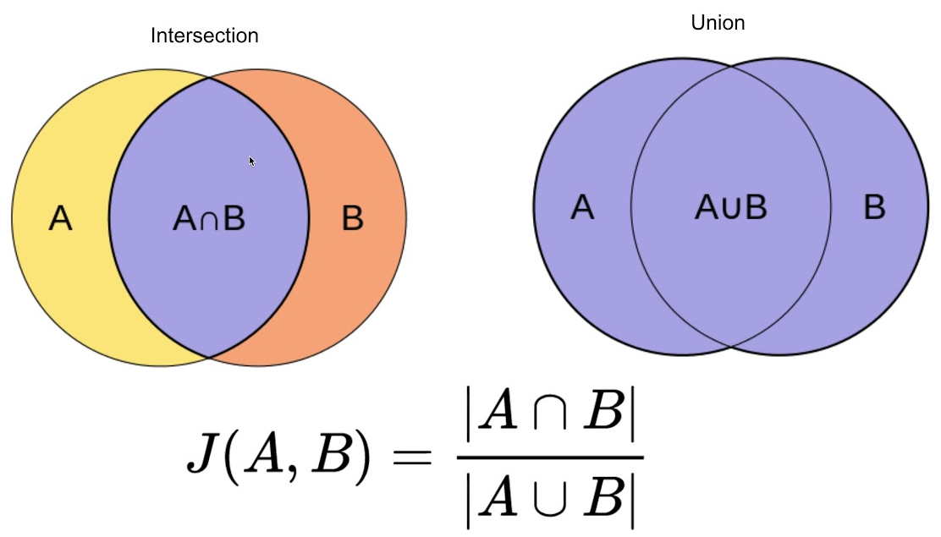

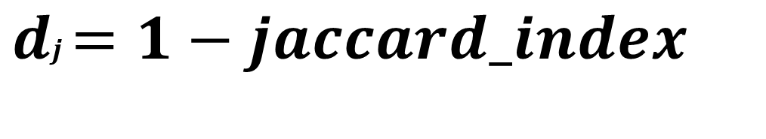
Jaccard Distance
It is a metric that measures the dissimilarity between two sets. It is derived from the Jaccard Index, which is a calculation between two sets by comparing the size of their intersection to the size of their union
$$\begin{matrix} \\ Jaccard Index=\frac{|A∩B|}{|A∪B|}\end{matrix}$$
$$\begin{matrix}dj=1−jaccard_index \\ \end{matrix}$$

Slide 18
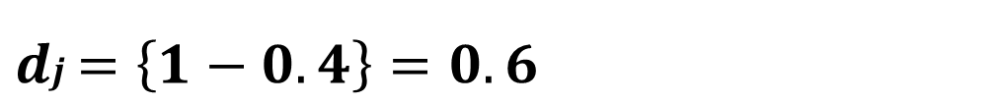
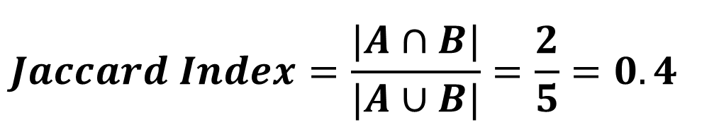
Example of Jaccard Distance
Set A: {apple, banana, cherry}
Set B: {banana, cherry, date, berry}
Solution:
Intersection (A ∩ B): {banana, cherry} |A ∩ B|: 2
Union (A ∪ B): {apple, banana, cherry, date, elderberry}, |A ∪ B|: 5
$$\begin{matrix} \\ Jaccard Index=\frac{|A∩B|}{|A∪B|}=\frac{2}{5}=0.4\end{matrix}$$
$$\begin{matrix} \\ dj=\left\{1−0.4\right\}=0.6\end{matrix}$$

Slide 19
Example of Jaccard Distance
doc_1 = “Data is the new oil of the digital economy”
doc_2 = “Data is a new oil”
Set doc_1: {Data, is, the, new, oil, of, digital, economy}
Set doc_2: {Data, is, a, new, oil}
Solution:
Intersection (doc_1 ∩ doc_2 ): {Data, is, new, oil}
| doc_1 ∩ doc_2 |: 4
Union (doc_1 ∪ doc_2 ): {Data, is, the, new, oil, of, digital, economy, a}
| doc_1 ∪ doc_2 |: 9

Slide 20
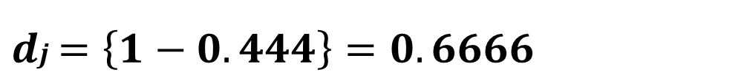
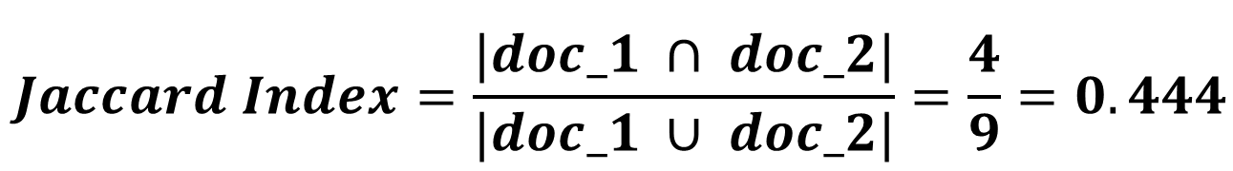
Example of Jaccard Distance
Solution:
Intersection (doc_1 ∩ doc_2 ): {Data, is, new, oil}
| doc_1 ∩ doc_2 |: 4
Union (doc_1 ∪ doc_2 ): {Data, is, the, new, oil, of, digital, economy, a}
| doc_1 ∪ doc_2 |: 9
$$\begin{matrix} \\ Jaccard Index=\frac{|doc_1 ∩ doc_2|}{|doc_1 ∪ doc_2|}=\frac{4}{9}=0.444\end{matrix}$$
$$\begin{matrix} \\ dj=\left\{1−0.444\right\}=0.6666\end{matrix}$$

Slide 21
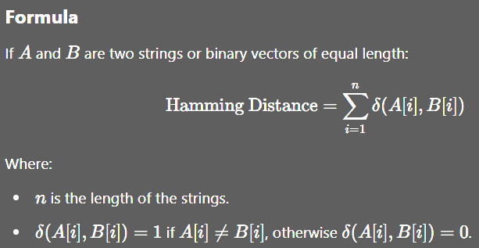
Hamming Distance
Hamming Distance is a metric used to measure the difference between two strings of equal length. It calculates the positions at which the corresponding symbols (characters or bits) differ.

Slide 22


Slide 23





Habits to Win Here and Hereafter | Dr. Tesneem Alkiek
URL: Habits to Win Here and Hereafter | Dr. Tesneem Alkiek
Total Duration: 01:00 Hrs

